Slide 1
Week 1 Lesson 4
History of the atom

Slide 2
Findings from a range of scientific experiments contributed to the understanding of the atom, enabling scientists, including Dalton, Thomson, Rutherford, Bohr and Chadwick to develop models of atomic structure and make reliable predictions about the mass, charge and location of the sub-atomic particles.
Refer page: 13-18 of Essential Chemistry Unit 1&2

Slide 3
John Dalton: Proposing the atomic theory
Over the period 1803-1808 Dalton presented and published a precise definition of the indivisible building blocks of matter ( atoms).
His atomic theory can be summarised as follows:
Elements are composed of extremely small particles called atoms.
Atoms of different elements have a different size, mass and chemical properties.
Atoms are not created nor destroyed or changed into different types during a chemical reaction.
A chemical reaction involves only separation, combination or rearrangement of atoms.
Compounds are formed when atoms of more than one element combine in a specific ratio.
Although Dalton had made great progress with his atomic theory by identifying elements as consisting of indestructible particles called atoms, he was unable to draw any conclusions as to their structure.

Slide 4
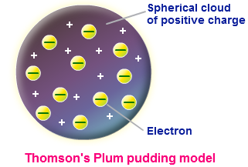
J.J.Thomson’s model of the atom
The first quantitative measurements of cathode ray particles( electrons) were produced in 1897 by Thomson using a modified cathode ray tube (CRT). Cathode rays passed as a narrow beam between a pair of charged metal plates and a magnetic field. As the rays passed through the magnetic field they experienced a sideways force causing the rays to move in a curved path. By adjusting the charge applied to the metal plates inside the tube it was possible to use the deflecting force of the charged plates to cancel the deflecting force of the magnetic field so that the cathode rays once again moved in a straight path.
Thomson showed that the negative particles which made up cathode rays ( now known as electrons), had an estimated mass of around 1/ 1000th that of the smallest known atom.
Thomson’s atomic model consisted of numerous very small negatively charged electrons imbedded within a much larger uniform positively charged sphere. The large spherical part of the atom accounted for almost all of its mass. His model, known as the ‘plum-pudding’ model of the atom, however, would prove to be short lived due to experimental work by Ernest Rutherford.

Slide 5
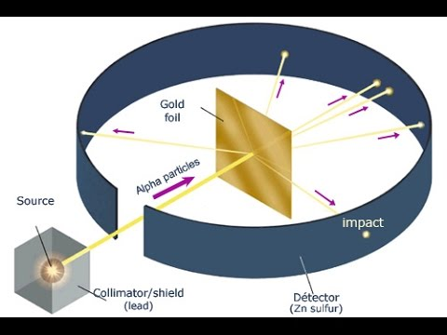
Rutherford’s model of the atom
Rutherford’s gold foil experiment involved directing a beam of alpha particles towards a thin sheet of gold foil. The scattered alpha particles are observed through a microscope as they cause a flash of light when they strike the ZnS coated screen. Most alpha particles in the beam pass straight through the gold foil. Some show a slight deflection, while a very small percentage of alpha particles are deflected backwards.

Slide 6
If Thomson’s ‘plum-pudding’ model of the atom was correct then all of the alpha particles would pass through the gold foil with little or no deflection. This he concluded as the positive charge and mass of Thomson’s atomic model was thinly and uniformly spread throughout the atom.
In Rutherford’s model almost all of the atom’s mass and all of its positive charge are located in the nucleus with the positive charge. This model explained why most of he alpha particles in Rutherford's gold foil experiment passed through the gold foil undeflected. The undeflected alpha particles had simply passed through the relatively empty region of the atom, the region occupied only by the very low mass particles called electrons. The very few alpha particles that passed close to or directly towards the tiny but dense and positively charged gold nuclei would show significant deflection or even be deflected backwards.

Slide 7
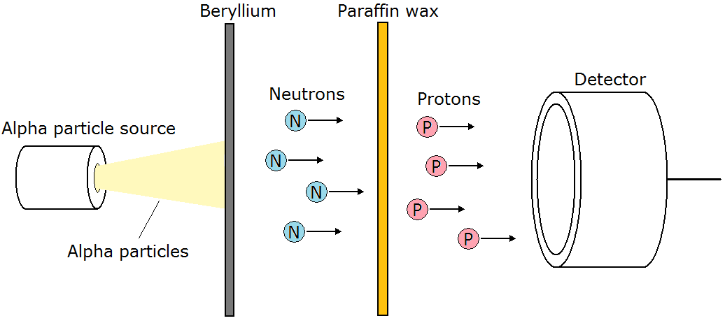
Chadwick’s discovery of the neutron
Rutherford’s model could not account for all of the atom’s mass. Experimental data by Hans Geiger and Ernest Marsden on the extent and frequency of alpha particle deflection showed the number of protons in the nucleus equalled half the atom’s relative mass. This means the protons could only account for half of the atom’s overall mass. Some other neutral particle must be present in the nucleus.
In 1932 Sir James Chadwick, a previous student and collaborator of Rutherford, identified the chargeless particle named neutrons as a product of the alpha particle bombardment of the metal Beryllium. For this he was awarded the Hughes Medal of the Royal Society in 1932 and later the Nobel Prize for Physics in 1935.

Slide 8
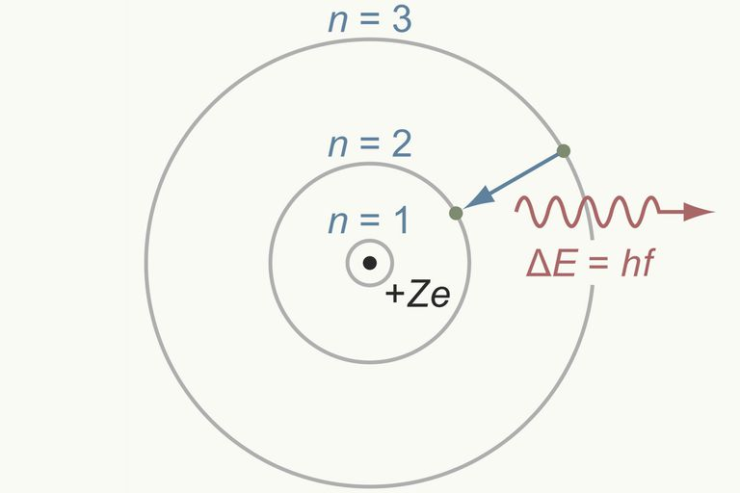
Bohr’s model of the atom
In 1913 the Danish physicist Niels Bohr applied concepts from the newly developing field of quantum theory to propose a modified version of Rutherford’s nuclear atom. His model proposed that electrons moved about the central nucleus in circular orbits, as was first proposed by Rutherford, but that only certain orbit radii are allowed. Bohr also postulated that the electron in each orbit had a specific amount of energy with the lowest orbital radii corresponding to the lowest possible energy.
Bohr hypothesised a single light photon would be emitted from an excited atom when one of its electrons fell from a higher energy orbit to a lower energy one. The energy of the emitted photon would equal the difference in energy of the two orbits.

